Slide 1

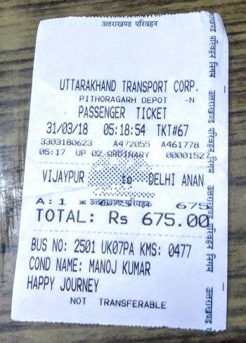
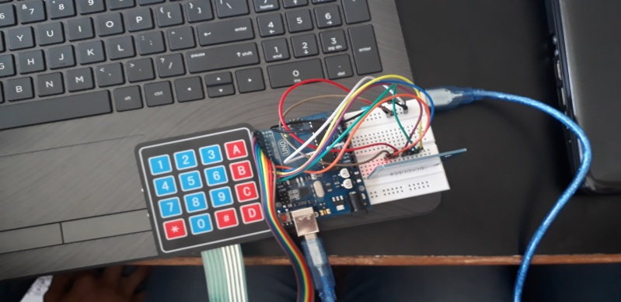
Problem
A lot of problems are faced during the manual work of bus pass system. So, we are developing a real time project useful for commuters which reduce the problem of the current paper based bus ticket system.

Slide 2

Solution
We have developed a real time project useful for commuters by implementing RFID Card System. RFID Reader will scan the card with a particular Card UID, which is unique to every card.
The card on scanning has the following functions to operate:
A. Recharge
B. Pay ticket price
C. Balance
D. Empty Card
Which will be executed by pressing the keys on the keypad.

Slide 3
Tech Stack
Microcontroller used for the programming (C++) on ARDUINO IDE is the ARDUINO UNO.
HARDWARE USED:
ARDUINO UNO
USB CABLE
RFID CARD READER/WRITER
RFID CARD/TAG
4X4 MATRIX KEYPAD
BREADBOARD
CONNECTING WIRES

Slide 4
Progress
We have completed the entire hardware assembly of the bus ticket system on the breadboard using the Arduino UNO, with all its connections with the RFID Card Reader/Writer (for scanning the RFID card/tag) and the 4x4 matrix keyboard (to take input).
We have added the following functions:
(According to the key to be pressed on the keyboard)
A. Recharge
B. Pay ticket price
C. Balance
D. Empty Card
On scanning the RFID card, any function (A,B,C or D) can be chosen and is executed via pressing the keys on the keypad.

Slide 5
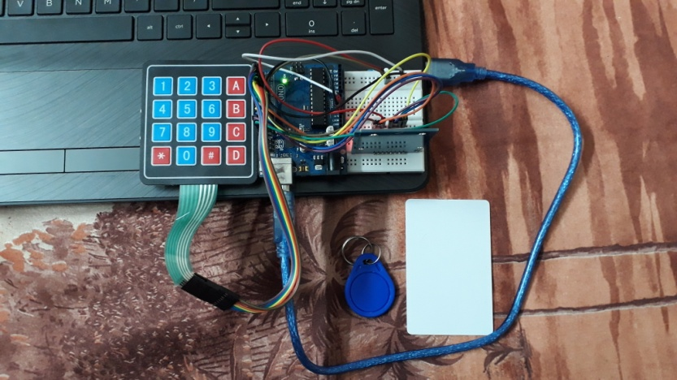
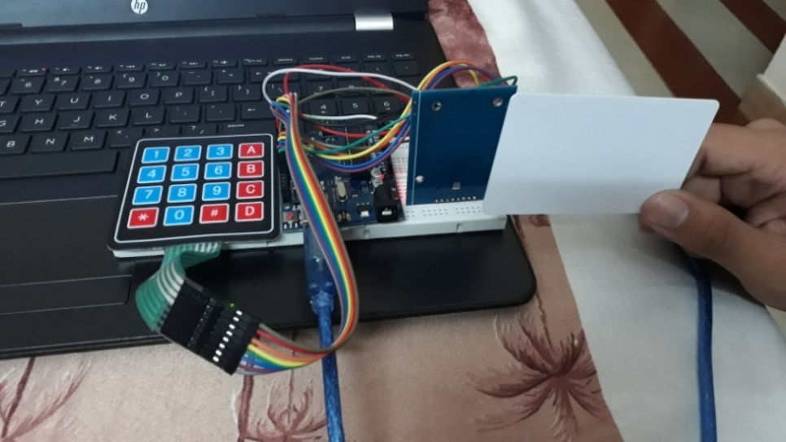
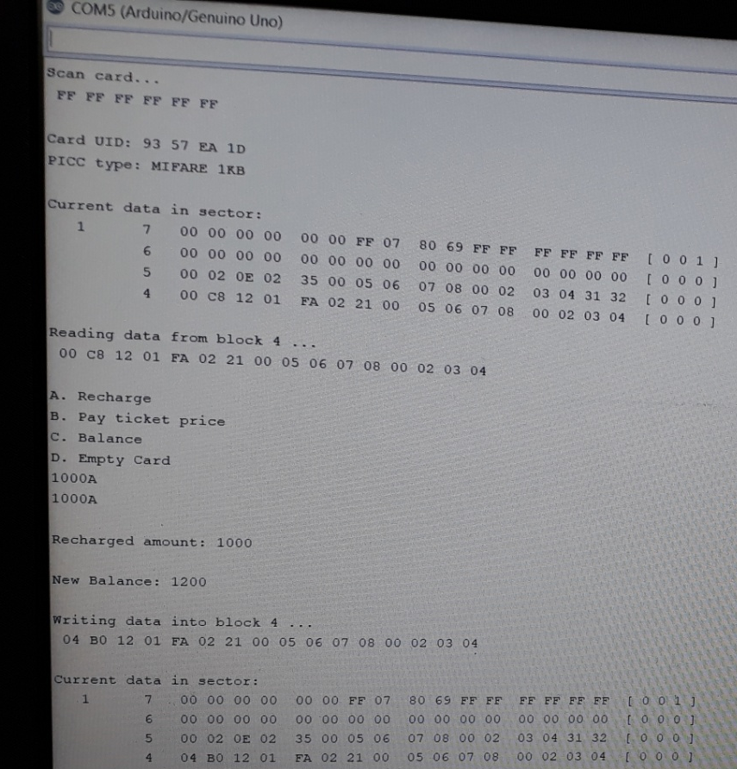
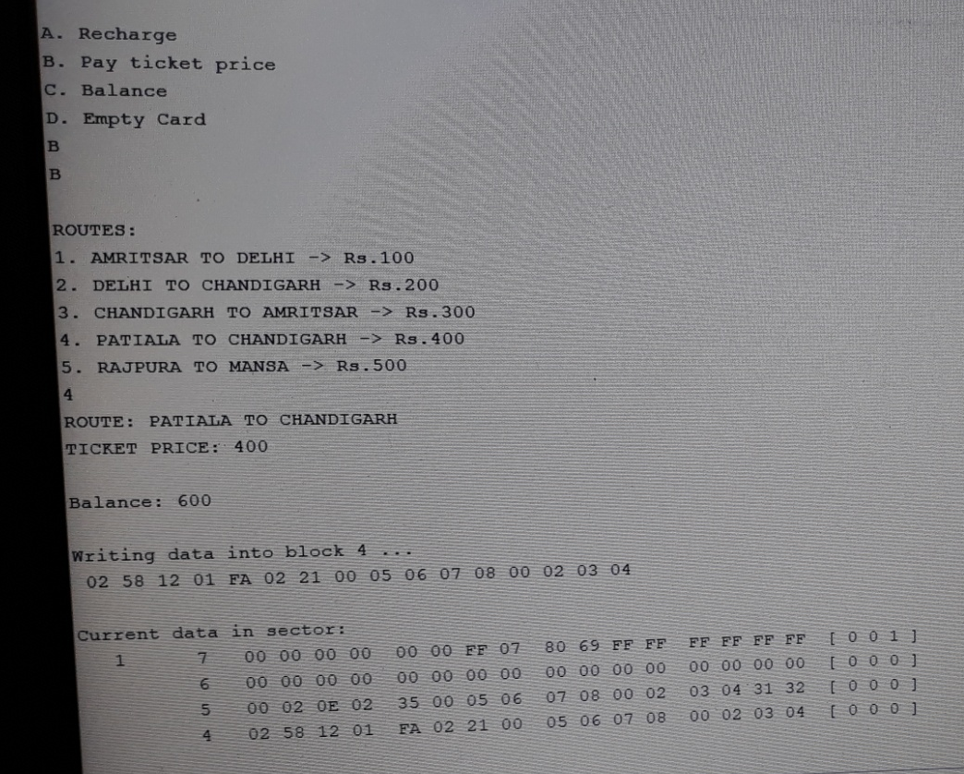
HARDWARE ASSEMBLY WITH RFID CARD AND RFID TAG
SCANNING THE RFID CARD WITH THE RFID SCANNER
PAYING THE TICKET PRICE FROM THE CARD ACCORDING TO THE CHOSEN BUS ROUTE
(PRESSING THE KEY B ON THE KEYPAD)
RECHARGING THE CARD WITH SOME AMOUNT (PRESSING THE KEY A ON THE KEYPAD)

Slide 6
Impact of solution
We are digitizing the bus ticket system.
The chaos of carrying cash is being solved.
The problem of responsibility of handling the ticket is being solved.
All transactions (recharge, payment, etc.) are carried out from the card itself.
Thus, reducing the problem of the current paper based bus ticket system.
It’s like your very own “wallet” but, in the form of a card.

Slide 7
Bottlenecks
The possibility of loss/theft of the card.
New card to be issued in that case.
The possibility of exchange of cards.

